Slide 1


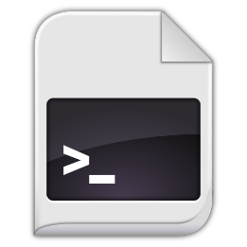
How It Works?
Pull
Push
git add
git commit
Modified
Staged
Commited
<number>

Slide 2
Basic Git Commands
Cloning an existing Git repository
Fetch and merge the latest changes from the remote repository
Preparing (adding / selecting) files for a commit
Committing to the local repository
git clone [remote url]
git pull
git add [filename] ("git add ." adds everything)
git commit –m "[your message here]"
<number>

Slide 3
Basic Git Commands (2)
Check the status of your local repository (see the local changes)
Creating a new local repository (in the current directory)
Creating a remote (assign a short name for remote Git URL)
Pushing to a remote (send changes to the remote repository)
git status
git init
git remote add [remote name] [remote url]
git push [remote name] [local name]
<number>

Slide 4
Using GitBash: Example
mkdir work
cd work
git clone https://github.com/SoftUni/test.git
dir
cd test
dir
git status
(edit some file)
git status
git add .
git commit -m "changes"
git push
<number>

